Slide 1
Code Basics Resume Project Challenge #13
Provide Insights to Chief of Operations in Transportation Domain
Good cabs Transportation Trends and Insights
Presented By
Kalyani Khandke

Slide 2
Agenda
1.Introduction - Overview of a Project
2.Key Metrics Overview - KPI Analysis
3.Data Model- Relationship and data Modeling
4.Primary Questions - Drive the deep analysis
5.Secondary Questions – More data insights
6.Dashboard- Understand the data through Visual
7.Key Insights –Meaningful solution
8.Recomandation – Overcome the problem

Slide 3

Introduction
Goodcabs, a Cab Service company which focused on tire -2 cities in India.
Supports local drivers and aims to deliver excellent passenger service.
Operates in 10 tier-2 cities across India.
Goodcabs Management Team aims to access the company’s performance across key metrics, including trip volume, passenger Satisfaction , Repeat passenger rate , trip distribution rate and balance between new and Repeated passenger

Slide 4
Key Metrics Overview
Total Trips
Total Fare(Revenue)
Total Distance Travelled
Passenger Avg. Rating
Driver Avg. Rating
Avg. fare per Trip
Avg. fare per KM
New vs Repeated Passenger Rate
Trip Distance
Repeat passenger rate

Slide 5
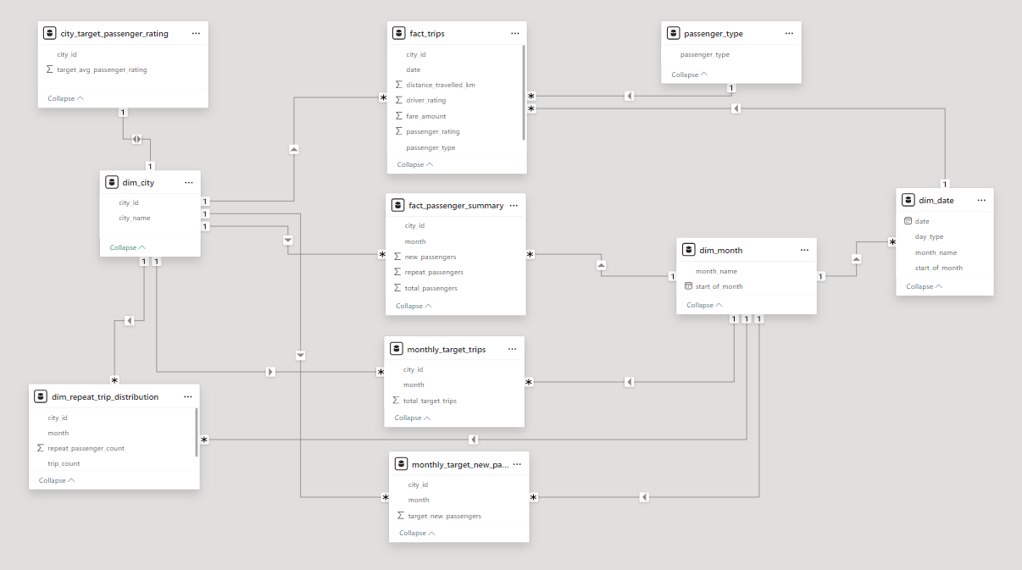
Data Model

Slide 6
Primary Questions

Slide 7
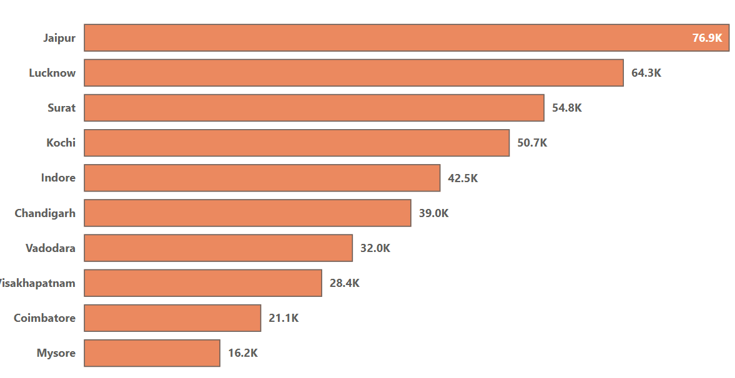
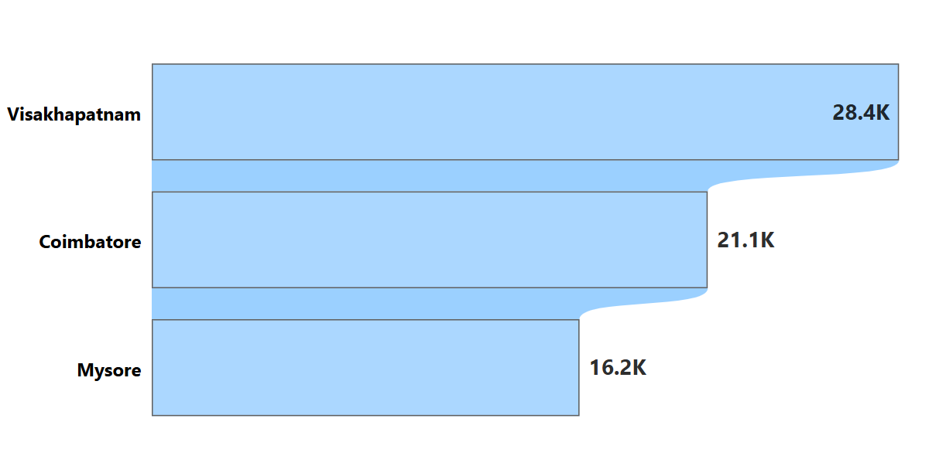
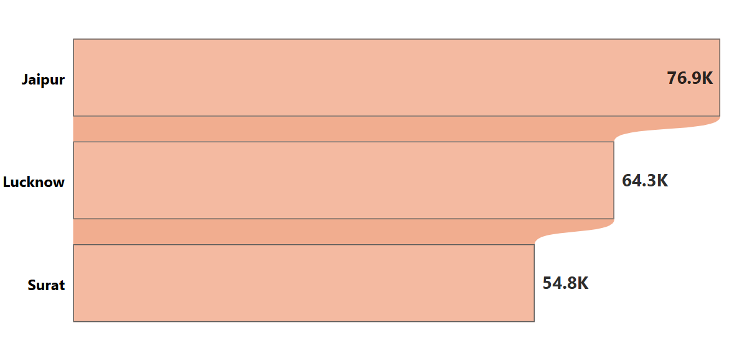
Q.1 Identify Top 3 and Bottom 3 cities by total trips over entire analysis periods
Bottom 3 Cities-
Vishakhapatnam-28.4k
Coimbatore-21.1k
Mysore-16.2 k
Top 3 Cities-
Jaipur-76.9 K
Lucknow-64.3K
Surat -54.8 K

Slide 8
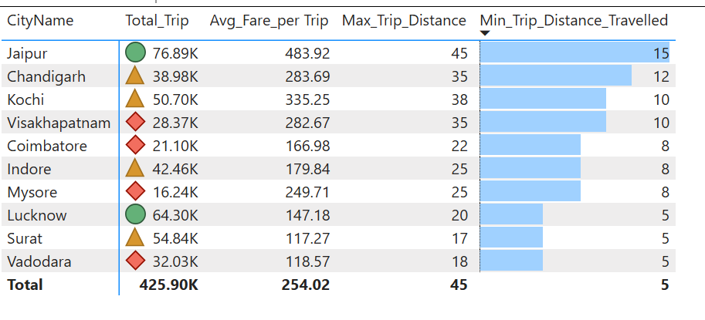
Q.2 Average. Fare per Trip by City Calculate The avg. fare Trip for Each City and compare it with city's avg trip distance . Identify Cities with highest and lowest avg. fare per trip to access pricing efficiency
Highest Avg fare per Trip - Jaipur -483 Rs
Lowest Avg fare Per trip-
-Surat – 117 Rs

Slide 9
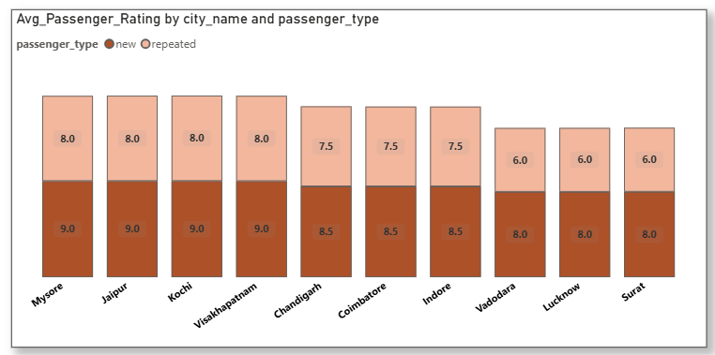
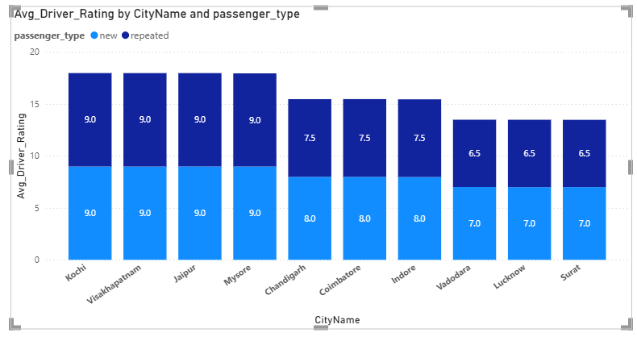
Q3. Average Rating by City and Passenger Type Calculate average passenger and driver rating for each city, segemneted by passenger type(new vs Repeated). Identify cities with highest and lowest avg rating
Highest Rating- Mysore ,Jaipur, Kochi
Lowest Rating – Vadodara, Lucknow, Surat

Slide 10
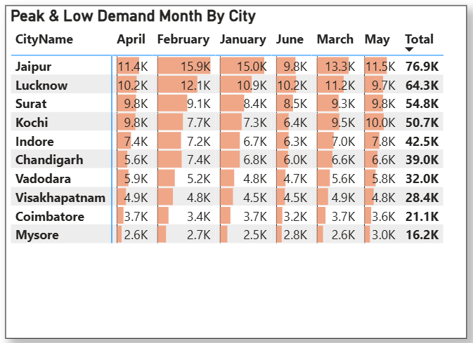
Q.4 Peak and Low Demand Months By city Calculate Month wise Highest Total Trip (High Demand) and Month wise lowest trip (Low Demand)
Peak Months- April, May
Low Demand Month - June

Slide 11
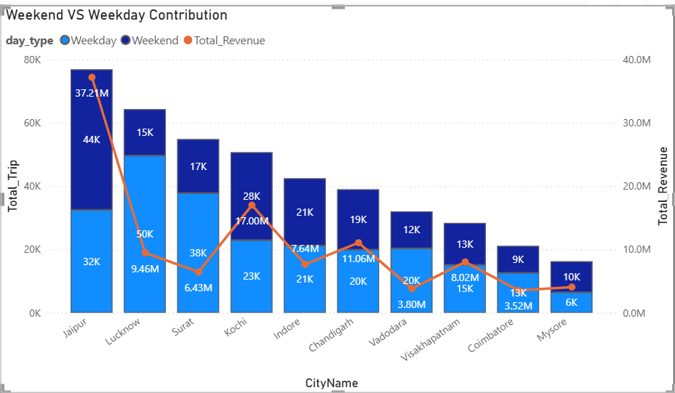
Q.6 Weekend Vs Weekday Trip Demand City Compare the total trips taken on weekend Vs Weekday for each City Over the six month
Weekday Trip Demand Cities
Lucknow
Surat
Vadodara
Coimbatore
Vishakhapatnam
Weekend Trip Demand Citi
Jaipur
Kochi
Chandigarh

Slide 12
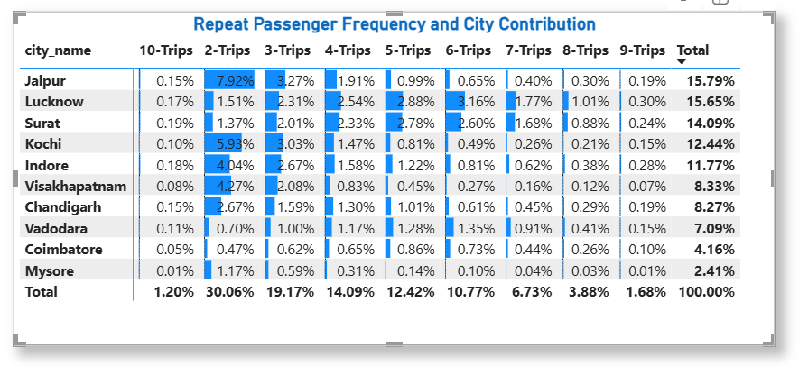
Q.7 Repeat Passenger Frequency and City Contribution Analysis Analysis the Frequency of Trip taken by repeat passengers in Each City

Slide 13
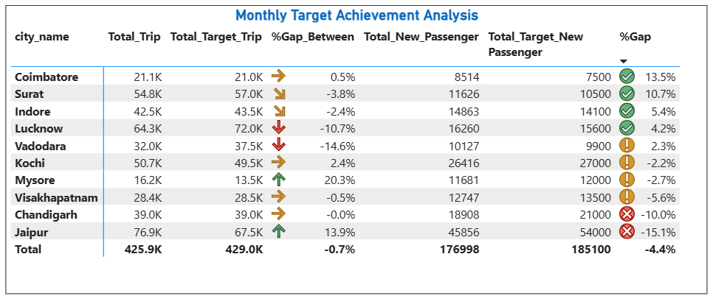
Q.8.Monthly Target Achievements Achievement Analysis for Key Metrics

Slide 14
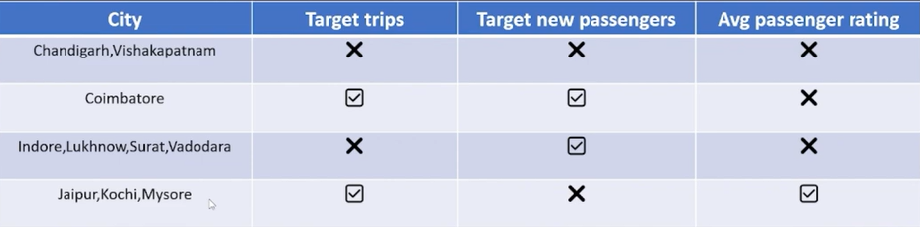
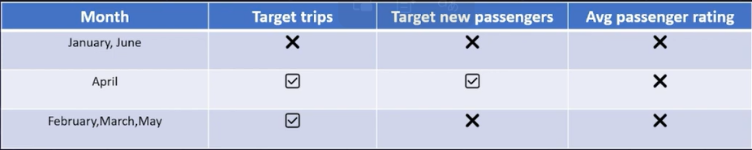
Business Cities Reached Target New Passengers and Tourism Cities achieved target of New Passengers and Avg Passengers rating.

Slide 15
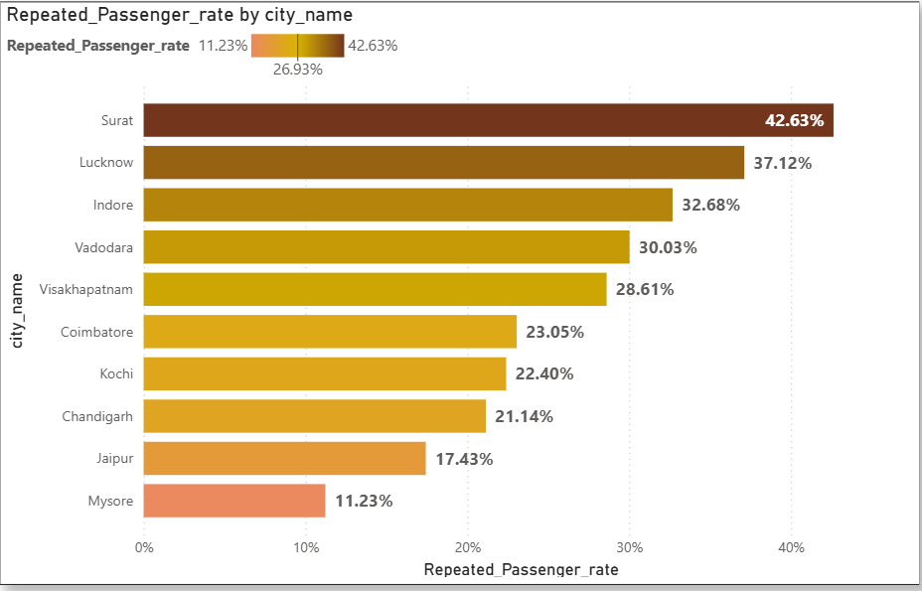
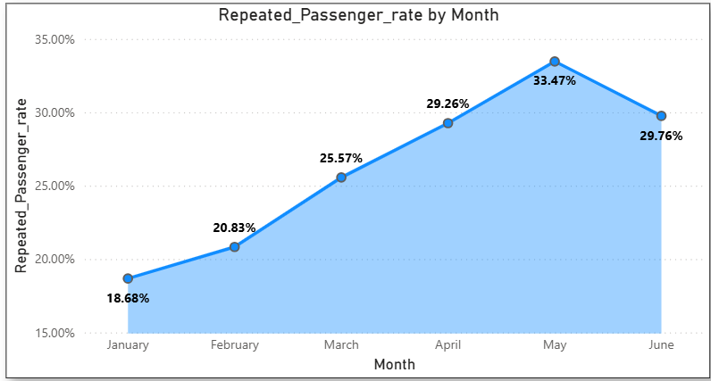
Q.9 Highest and Lowest Repeat Passenger rate By city and Month (RPR %)
Top 2 cities– Surat ,Lucknow
Bottom 2 Cities – Mysore ,Jaipur
RPR %- Highest Month – May
Lowest Month - January

Slide 16
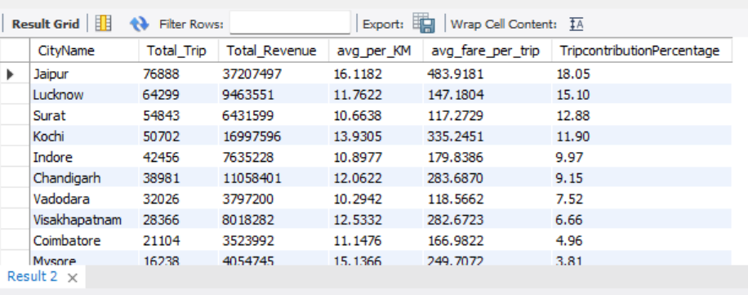
Business Request 1-City level fare and Summery Report

Slide 17
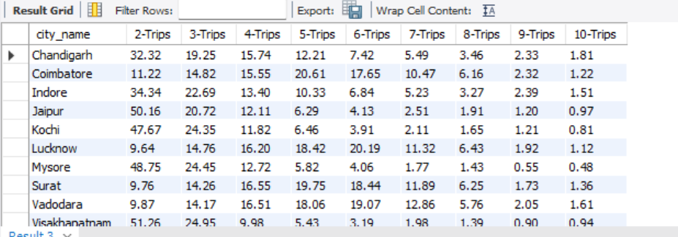
business request -2 City-level Repeat Passenger trip frequency Report

Slide 18
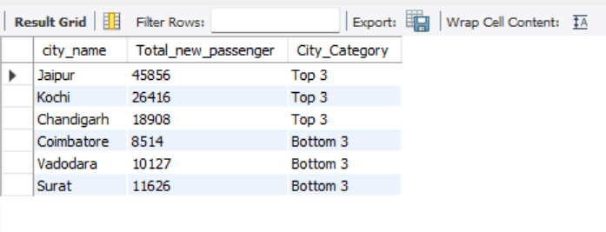
4. Identify cities with Highest and lowest cities with total_new passenger

Slide 19
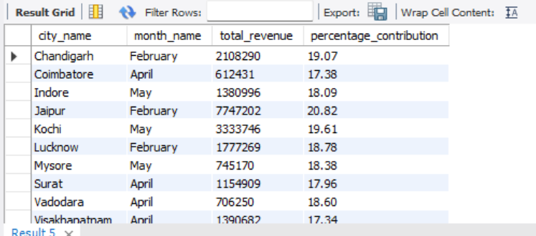
5. Identify month with highest revenue for each city

Slide 20
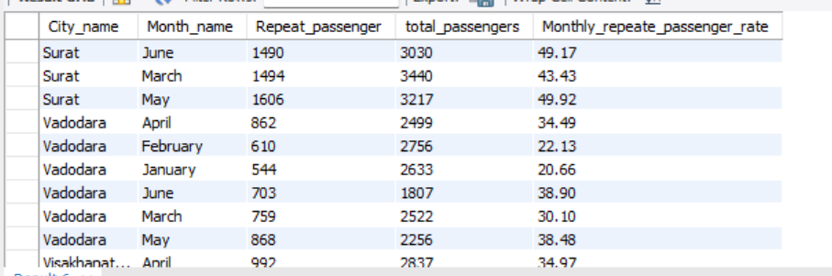
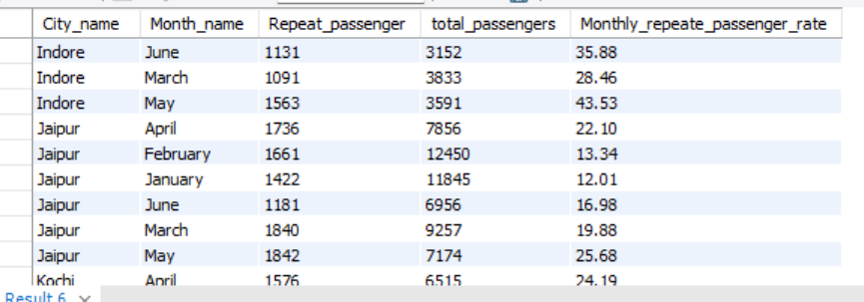
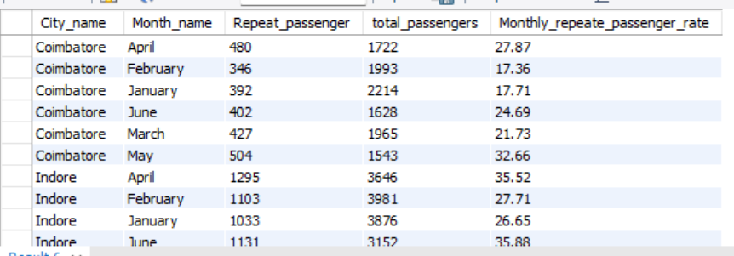
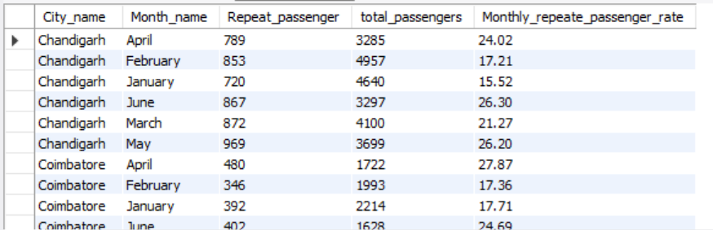
Q.6 Repeate passenger Rate Analysis--

Slide 21
Key Insights
Trip volume and Revenue
Peak Month- February & March show highest trip volume with February leading (75.4k) trips
Top Revenue cities- Jaipur, Kochi and Chandigarh generate most revenue with Jaipur leading (37.2M)
Passengers Trends
Repeat Passenger – High In surat (42.6%) and lucknow (37.1%),but low in Jaipur (11.2%)
New Passenger- Highest in Jan-Feb, Declining in May-June
Fare and Trip Distance-
Cities Like Jaipur have higher fares(484) due to longer trips while surat fare is lower (117) with shorter trips(11Km)

Slide 22
Customer Rating – Jaipur, Kochi and Mysore have high rating , while lucknow ,surat and Vadodara have low rating
Weekend Vs Weekday Trends-
Tourism cities have higher weekend trip volums while business cities have higher volume on weekday
Repeat passenger rate- its peak in May(33.5%)
City Performance against Target-
Business cities met passengers target but missed trip volume and target rating while tourism cities met trip target but rating are below target

Slide 23
Recommendation
Improve Service Quality
Dynamic Pricing Strategy.
Enhanced Customer Retention.- Increase Repeat passenger Rate through loyalty Program and Improved Service Offering.
Expand Vs Fleet – Integrate Eco friendly Vehical in high Demand
Leverage Seasonal trends-
Prioritize marketing and Promotion around Peak months and Weekend in tourism in tourism cities.

Slide 24
Thank You

